Slide 1

Introduction to Support Vector Machines

Slide 2

What is SVM ?
Support Vector Machine is a supervised machine learning technique that can be used to solve issues such as classification and regression.
It transforms data using a process known as associated learning, and then identifies an ideal boundary between the potential outputs depending on the transformation.

Slide 3
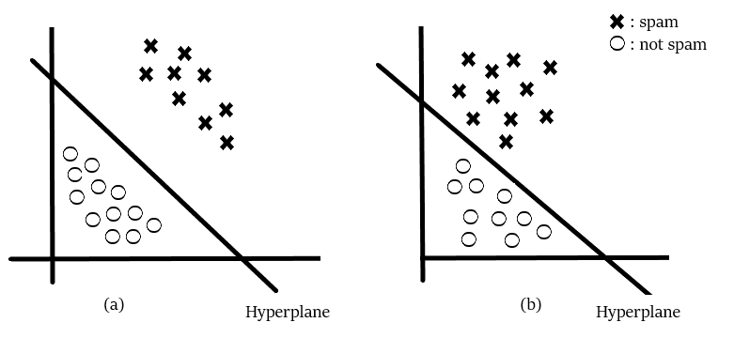
Working with an Example
You have a stalker that sends you emails, and you want to create a function (hyperplane) that will clearly distinguish between the two instances, such that any emails from the stalker will be categorized as spam.
Which of the two scenarios in which the hyperplane is drawn do you think you would choose and why?
Take a moment to analyze the situation.

Slide 4
Working with an Example
I'm sure you would have chosen the fig (a).
Did you consider why you choose the fig(a)?
Because the emails in fig(a) are clearly categorised, you have more confidence in them than the ones in fig(b) (b).
SVM is based on the concept of creating an ideal hyperplane that will clearly classify the various classes (in this case they are binary classes).

Slide 5
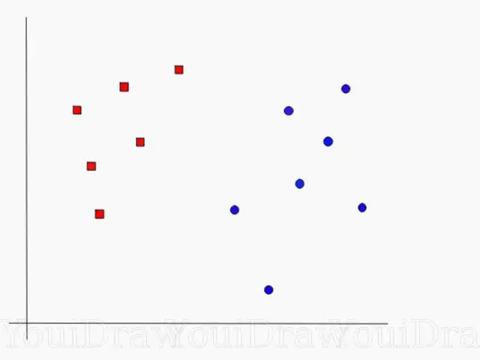
Intuition of SVM
Suppose you have a dataset as shown below and you need to classify the red rectangles from the blue ellipses(let’s say positives from the negatives).
So your task is to find an ideal line that separates this dataset in two classes (say red and blue).

Slide 6
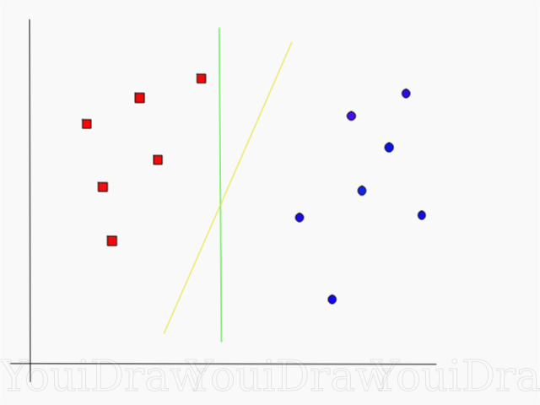
Intuition of SVM
We have two candidates here, the green colored line and the yellow colored line.
Which line according to you best separates the data?

Slide 7
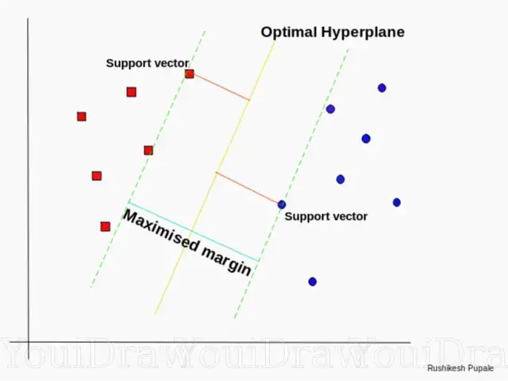
Intuition of SVM
According to the SVM algorithm we find the points closest to the line from both the classes.
These points are called support vectors.

Slide 8
Intuition of SVM
Now, we compute the distance between the line and the support vectors. This distance is called the margin.
Our goal is to maximize the margin. The hyperplane for which the margin is maximum is the optimal hyperplane.

Slide 9
Assumptions of SVM
Support Vector Machines (SVMs) are a type of supervised learning algorithm used for classification and regression analysis. The following are the assumptions of SVMs

Slide 10
Assumptions of SVM
Linearly separable data: SVMs work best when the data is linearly separable, which means that a straight line can be used to separate the two classes of data.
Binary classification: SVMs are designed for binary classification problems, meaning that they are intended to classify data into two distinct classes.
Margins matter: SVMs maximize the margin between the decision boundary and the closest data points of each class. This means that SVMs are designed to find the boundary that maximally separates the two classes.

Slide 11
Assumptions of SVM
Feature selection: SVMs assume that the input data has been preprocessed to remove irrelevant features and select the most informative ones. This is because SVMs are sensitive to the number of features, and using too many irrelevant features can lead to overfitting.

Slide 12
Assumptions of SVM
Regularization: SVMs use regularization to prevent overfitting by adding a penalty term to the objective function that encourages the model to select a simpler decision boundary. This is achieved through the choice of the regularization parameter, which determines the trade-off between fitting the training data and finding a simpler decision boundary.

Slide 13
Assumptions of SVM
Kernel functions: SVMs can handle nonlinear data by mapping the input data to a higher-dimensional space using a kernel function. This allows SVMs to find a nonlinear decision boundary in the transformed space, which corresponds to a linear decision boundary in the original space.

Slide 14

Mathematical Formulation of SVM
Support Vector Machines (SVMs) are a type of supervised learning algorithm used for classification and regression analysis. The mathematical representation of SVM can be described as follows:
Given a training dataset consisting of n data points {x1, x2, ..., xn} and their corresponding labels {y1, y2, ..., yn}, where yi ∈ {-1, 1} for binary classification problems, SVMs aim to find a hyperplane that separates the two classes with maximum margin.

Slide 15
Mathematical Formulation of SVM
The hyperplane can be represented as:
w·x + b = 0
where w is a weight vector, b is a bias term, and · denotes the dot product of vectors. The decision function of SVMs is defined as:
f(x) = sign(w·x + b)
where sign is the sign function that returns -1 or 1 depending on the sign of the argument. The decision function f(x) assigns each input data point x to one of the two classes based on the sign of w·x + b.

Slide 16
Mathematical Formulation of SVM
The optimal hyperplane is found by solving the following optimization problem:
minimize ½ ||w||^2
subject to yi(w·xi + b) ≥ 1 for i=1,2,...,n
where ||w||^2 is the L2 norm of the weight vector, which measures the complexity of the decision boundary, and the second constraint ensures that all data points are correctly classified with a margin of at least 1.

Slide 17
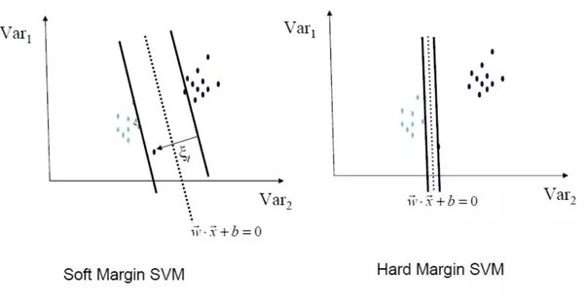
Types of SVM Classification (Soft VS Hard Margin)
Hard Margin SVM:
Hard Margin SVM is a type of SVM that requires the training data to be linearly separable with a large margin between the two classes.
The hard margin SVM aims to find a hyperplane that separates the two classes with maximum margin, such that all data points are correctly classified and lie outside the margin.
In hard margin SVM, any misclassification results in the failure of the algorithm, and there is no room for error. This approach is also known as strict SVM.

Slide 18
Types of SVM Classification (Soft VS Hard Margin)
Soft Margin SVM:
Soft Margin SVM is a type of SVM that allows some misclassification errors to occur during training.
This is done by introducing a slack variable that allows some data points to be misclassified, but at the same time, penalizes the model for misclassification.
The objective of the soft margin SVM is to find a hyperplane that maximizes the margin between the two classes while minimizing the misclassification error.

Slide 19
Types of SVM Classification (Soft VS Hard Margin)
Soft Margin SVM:
The level of tolerance for misclassification is controlled by a regularization parameter called C.
The smaller the value of C, the more tolerant the model is to misclassification, and vice versa.
Soft Margin SVMs are generally more flexible and robust than Hard Margin SVMs, as they can handle noisy or overlapping data.

Slide 20
Applications of SVM
Face detection is the process of classifying elements of a picture as a face or non-face and drawing a square boundary around the face using an SVM classifier.
Text detection occurs when an SVM classifier distinguishes between text and hypertexts, allowing the model to readily classify both classes.
Protein classification and cancer classification are two examples of bioinformatics. SVM is used to detect gene classification, patient classification based on genes, and other medical difficulties.

Slide 21
Applications of SVM
Protein fold and remote homology identification uses SVM methods to find protein distant homology.
One of the most common uses of SVM is handwriting recognition.
Use SVM-based generalised predictive control (GPC) to control chaotic dynamics using usable parameters.

Slide 22
Pros and Cons of SVM
Pros:
It is extremely effective on a higher level.
When the number of features exceeds the number of training examples, it is effective.
When classes are separable, the best algorithm is used.
Because only the support vectors affect the hyperplane, outliers have less impact.

Slide 23
Pros and Cons of SVM
Cons:
Processing a huge dataset involves a significant amount of time.
Doesn't work well when there are multiple classes that overlap.
Choose appropriate SVM hyperparameters that allow for adequate generalisation performance.
Choosing the right kernel function can be difficult.

